Slide 1
Complexity of conventional Sorting Algorithms
Course Code: CSC2211
Course Title: Algorithms
Dept. of Computer Science
Faculty of Science and Technology
Lecturer No: |  | Week No: | 02 | Semester:
Lecturer: | Name & email

Slide 2
Lecture Outline
1. Sorting Algorithms
Insertion Sort
Selection Sort
Bubble Sort
Merge Sort
Quick Sort
Counting Sort

Slide 3
Sorting
Simple sorting methods use roughly n * n comparisons
Insertion sort
Selection sort
Bubble sort
Fast sorting methods use roughly n * log n comparisons.
Merge sort
Quicksort
Fastest sorting methods use roughly n
COUNTING SORT ??

Slide 4
Sorting Algorithms with Polynomial time

Slide 5
Bubble Sorting
Concept:
Compare 1st two elements
If out of order, exchange them to put in order
Move down one element, compare 2nd and 3rd elements, exchange if necessary. Continue until end of array.
Pass through array again, exchanging as necessary
Repeat until pass made with no exchanges.

Slide 6
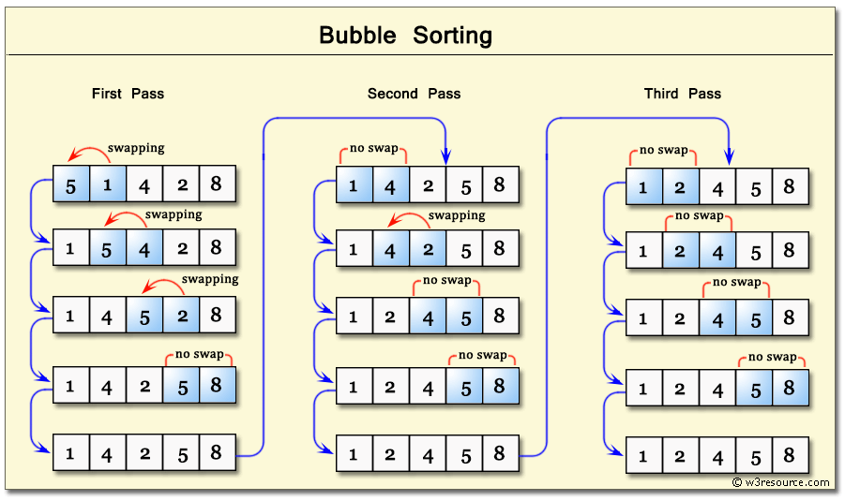

Slide 8
Selection Sorting
Concept for sort in ascending order:
Locate smallest element in array. Exchange it with element in first position
Locate next smallest element in array. Exchange it with element in position 1.
Continue until all elements are arranged in order

Slide 9
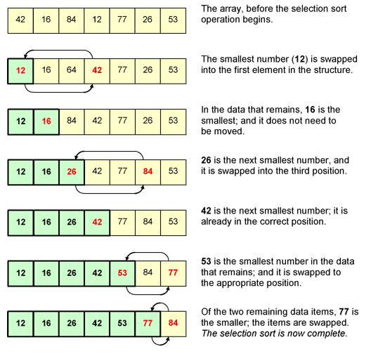

Slide 10
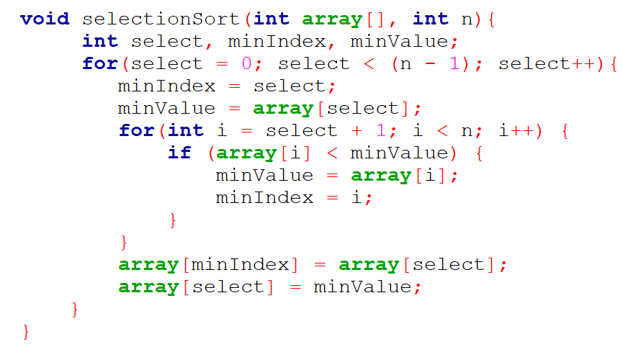
Selection Sort Algorithm

Slide 11
Sorting Algorithms with n(logn) time

Slide 12
Divide and Conquer
Recursive in structure
Divide the problem into independent sub-problems that are similar to the original but smaller in size
Conquer the sub-problems by solving them recursively. If they are small enough, just solve them in a straightforward manner.
This can be done by reducing the problem until it reaches the base case, which is the solution.
Combine the solutions of the sub-problems to create a solution to the original problem

Slide 13
Merge Sort
Sorting Problem: Sort a sequence of n elements into non-decreasing order.
Divide: Divide the n-element sequence to be sorted into two subsequences of n/2 elements each
Conquer: Sort the two subsequences recursively using merge sort.
Combine: Merge the two sorted subsequences to produce the sorted answer.

Slide 14
Merge Sort Analysis
The divide step takes constant time, regardless of the subarray size. After all, the divide step just computes the midpoint q of the indices p and r. Recall that in big-O notation, we indicate constant time by O(1).
The conquer step, where we recursively sort two subarrays of approximately n/2 elements each, takes some amount of time, but we'll account for that time when we consider the subproblems.
The combine step merges a total of n elements, taking O(n) time.

